Slide 1
Assess Uncertainty in Estimates by Bootstrap
SPADE course 2025
Notes:
Until now we have seen the results of the habitual intake distributions in some examples. The estimated mean, percentiles and fraction of the population between or above some cut-off points are alle point estimates.
But what about their uncertainty? Can we assess the uncertainty of those
point estimates?

Slide 2
We can now generate a lot of estimates..
Mean, percentiles, percentages below EAR / above UL …
For different nutrients …
For different age-classes …
And for different subgroups
AM P5 P10 P25 P50 P75 P90 P95
(0,79] 890 474 549 686 862 1064 1267 1397
(0,13] 713 373 431 544 687 853 1028 1141
(13,17] 784 418 486 607 759 934 1119 1233
(17,50] 907 506 577 711 881 1075 1274 1400
(50,79] 957 545 617 755 930 1131 1333 1463
Question : how 'good/certain' are these estimates?

Slide 3
Why uncertainty?
Different sources of uncertainty
For interpretation of results
Comparing results of 2 surveys: is the actual habitual sugar intake significantly lower compared to the previous one?
Measurement error (e.g. recall error)
Sampling error aka parameter uncertainty
Model error aka structural uncertainty
we’ll only address this one

Slide 4



















Theoretical way of finding uncertainty
Repeat the complete several times
Gathering data
Process data
Analyse data
Every time you get a different outcome
collection of these outcomes show how (un)certain the outcome is
The Netherlands
~18 milion inhabitants
sample
…
process & analyse
Mean, P5, %<EAR, …
Mean, P5, %<EAR, …
…
Mean, P5, %<EAR, …
food consumption survey

Slide 5

Dutch National Food Consumption Survey
The target population is
The Netherlands
Sampled, with special design and select without replacement
DNFCS survey / sample years 2012-2016
The Netherlands
17.550.000 inhabitants
sampled
Raw data + NEVO table
Process
men 2165
women 2148
total 4313
=
Notes:
First our data:
as an example: Dutch National Food Consumption Survey
sampled with a stratified design from the Dutch population,
with almost 17.550.000 citizens
Randomly selected following a design without replacement (this means each person is selected once and then another person is selected, to have as much as possible variation in the survey)
so there are 4313 unique persons in our DNFCS dataset
Behind this scheme is an immense workload for years to
obtain participants,
with dietists, obtain their intakes on two independent days
clean the data and 'translate' their data into intakes about micronutrients, nutrients and food (klopt dit zo?) MDJ: je kan ook zeggen dat ze van voedingsdagboekjes naar micronutrient, nutrient en voedselinname gaan?
After all this work the data is ready and we can use SPADE for the estimation of the habitual intake distributions for the population, which involves also survey weights

Slide 6
We cannot repeat the survey itself, but…
What if we pretend the survey itself is the population?
Then generate ‘new surveys’ of the same size by drawing persons randomly from the original survey with replacement
This is called bootstrapping
Notes:
Even if repetition itself is a Mission Impossible, the movies do have always a more or less credible solution. And also here, there is a way to still assess the uncertainty of our estimates:
use the sample itself as if was the population. And then you can think about two solutions
without replacement: but the how much or with

Slide 7
original survey
NB: if the same person is resampled multiple (e.g. 3) times: treat them as 3 different persons (with identical observations)
resample
…
bootstrap samples
process & analyse
Mean, P5, %<EAR, …
Mean, P5, %<EAR, …
Mean, P5, %<EAR, …
…
Mean, P5, %<EAR, …
estimates
used for confidence intervals

Slide 8
Technical details
SPADE uses stratified resamping: for each level of age (and for gender), the same number of persons are resampled as in the original sample
Typically require 200 – 1000 bootstrap samples
We assume that the bootstrap samples of any outcomes are normally distributed

Slide 9
Illustration: finding confidence intervals for mean calcium intake
Output table bootstrap n.boot
Example: interested in AM of agegroup (0, 79]
Estimate (from original data): 890 μg/d
For every bootstrap samples → find the AM
Calculate:
mean(AM bootsamples) = b.mean = 888 μg/d
standard error (AM bootsamples) = b.sd = 11 μg/d
Lower bound CI = b.mean + 1.96 * b.sd = 867 μg/d
Upper bound CI= b.mean + 1.96 * b.sd = 910 μg/d
Output table bootstrap …
Output table bootstrap 2
Output table bootstrap 1
Output table original data
spade output table for ca
AM P5 P50 P95 (0,79] 890 473 863 1401 (0, 8] 692 361 667 1107
LB
b.mean
UB
HI
867
888
890
910

Slide 10
Bootstrap for f.spade - script
Without bootstrap
f.spade( frml.ia = ca ~ fp(age), frml.if = "no.if", data = DNFCSmanual, min.age = 1, max.age = 79, sex.label = "female", age.classes = c(0,12,18,30), weights.name = "w_demog_season_wk_wknd", seed = 09072025, spade.output.path = "0_SPADE_OUTPUT")
With bootstrap
f.spade.bootstrap(FUN = f.spade, frml.ia = ca ~ fp(age), frml.if = "no.if", data = DNFCSmanual, min.age = 1, max.age = 79, sex.label = "female", age.classes = c(0,12,18,30), weights.name = "w_demog_season_wk_wknd", seed = 09072025, spade.output.path = "0_SPADE_OUTPUT") stratum.name = "age", boot.alpha = 0.05, (significance level) n.boot = 200, (B, nr b.replicates) n.sgbs.fac = 3)
optional
Notes:
Extra 4 arguments for the bootstrap stratum.name, the column for the stratified sampling, boot.alpha the significance level, n.boot the number of bootstrap samples to be samples and n.sgbs.fac the factor for more bootstraps in case of non convergence. Note if these default values are ok, you may omit them!

Slide 11
Using f.spade.subgroups.bootstrap
Works analogously to f.spade.bootstrap
Output filenames slightly different
For extra grouping variable: length of column name can be at most 4 characters!
Limit is caused by maximum length of sheet names in Excel (32 characters).
Don't use dots "." in data and variable names but underscores "_" or use CamelStyle

Slide 12
Strategy for running a new f.spade.bootstrap script
To run a new f.spade.bootstrap
the ideal situation:
first run f.spade for your model and do the diagnostic checks
check the plots: QQ-plot residuals
check the ratio of the within-/between pers. variance
check the relative difference between the (weighted) observations and the overall mean of the habitual intakes
if everything is all right:
check if your f.spade.bootstrap script is working correctly
run the script with n.boot = 3
if this script runs, set
n.boot = 200
and run the script
Potential problems
tab-names too long for Excel
not enough convergences, caused by
too small groups or 'influencers’
too many covariables in f.spade3
Notes:
The check is important e.g. 1) in making the plots, 2) if names don't become too long etc.

Slide 13
Output in the Console
output for the original model, since this is run again
Logs of finished bootstraps
the final tables for
HI = habitual intakes orig.mod
LB = lower bound CI
UB = upper bound CI

Slide 14
Ouput console for f.spade.bootstrap
****************************** *** Start bootstrap cycles *** ****************************** Bootstrap step 1 with sample nr. 1 Bootstrap step 2 with sample nr. 2 Bootstrap step 3 with sample nr. 3 ... Bootstrap step 198 with sample nr. 198 Bootstrap step 199 with sample nr. 199 Bootstrap step 200 with sample nr. 200

Slide 15
Ouput console for f.spade.bootstrap
******************************
*** Total habitual intake ***
****************************** $HI
AM P5 P10 P25 P50 P75 P90 P95
(0,30] 787 414 478 600 759 944 1129 1253
(0,12] 710 373 432 542 685 849 1023 1130
(12,18] 783 424 487 604 758 932 1110 1229
(18,30] 856 470 538 666 831 1018 1205 1328
$LB
AM P5 P10 P25 P50 P75 P90 P95
(0,30] 765 394 459 583 739 915 1091 1204
(0,12] 694 354 414 526 669 830 991 1094
(12,18] 755 398 462 581 731 899 1067 1176
(18,30] 826 445 514 641 801 980 1158 1272
$UB
AM P5 P10 P25 P50 P75 P90 P95
(0,30] 802 431 494 616 775 963 1160 1290
(0,12] 724 390 448 557 699 869 1047 1165
(12,18] 802 444 506 624 777 957 1144 1268
(18,30] 878 495 561 688 851 1043 1242 1373
Notes:
Uitleggen AM en P warden eenvoudig zie eerste exercise. EAR1 and EAR1.p idem wel de NA's uitleggen voor EAR
iden AI en AI.p (waarbij geen CI's gemaakt kunnen worden)

Slide 16
Output of f.spade.bootstrap outside R
All filenames get prefix boot_
In folder spade.output.path:
1_plots boot_spade_DNFCSmanual_ca_f_1_79.pdf
2_logbooks 3 files: …_logbook.txt, …_details.txt, …_logbook.xlsx
3_excel_tables boot_spade_DNFCSmanual_ca_f_1_79.xlsx + boot_spade_DNFCSmanual_ca_f_1_79_AI2.csv
4_r_binaries 3 files: …_array.bin, …_model.bin, _table.bin

Slide 17
Output pdf file in 1_plots
boot_spade_DNFCSmanual_ca_f_1_79.pdf
simply contains (almost) all plots of the original data for the f.spade model

Slide 18
Output of f.spade.bootstrap outside R
The ouput of f.spade.bootstrap outside R is organized in 4 folders in main folder, defined by argument spade.output.path
1_plots boot_spade_DNFCSmanual_ca_f_1_79.pdf
2_logbooks 3 files: …_logbook.txt, …_details.txt, …_logbook.xlsx
3_excel_tables boot_spade_DNFCSmanual_ca_f_1_79.xlsx + boot_spade_DNFCSmanual_ca_f_1_79_AI2.csv
4_r_binaries 3 files: …_array.bin, …_model.bin, _table.bin

Slide 19
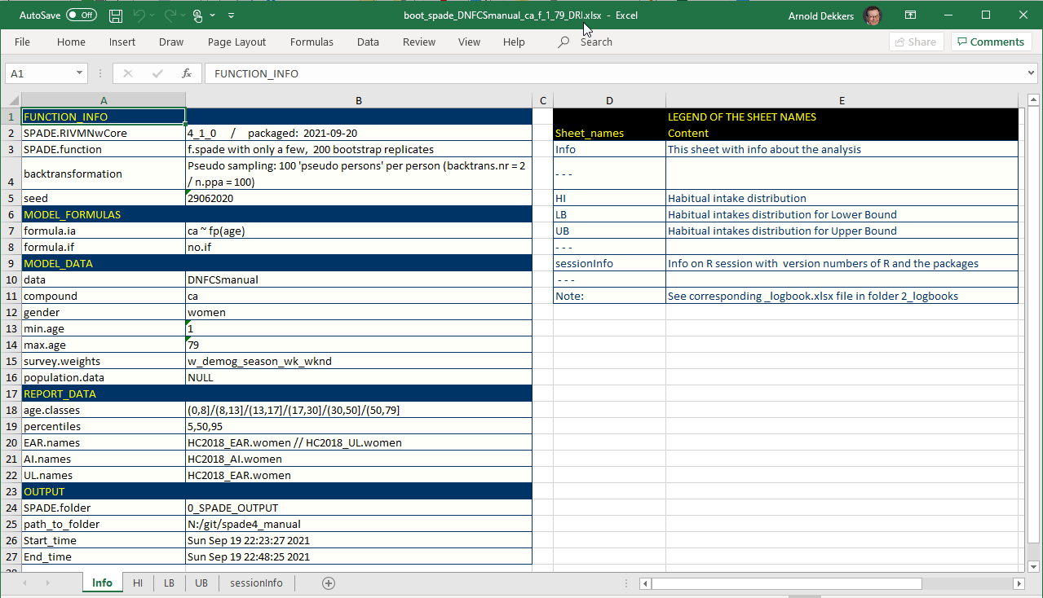

Slide 20
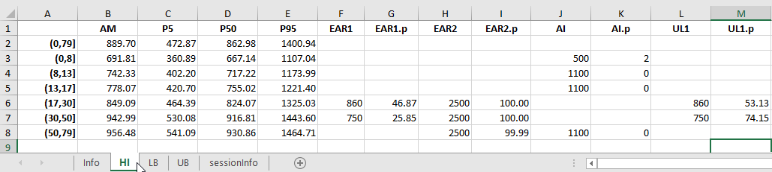
Output f.spade.bootstrap: Excel file, sheet HI

Slide 21
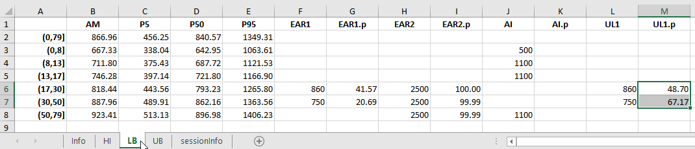
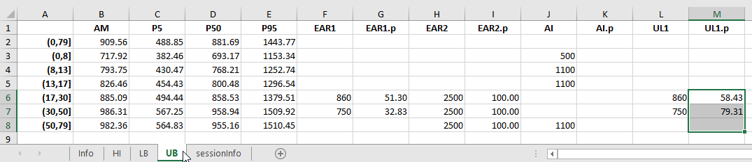
m
Output f.spade.bootstrap:Excel file, sheet LB/UB

Slide 22
Bootstrap in SPADE
f.spade.bootstrap for
f.spade 1-/2-part ch. 3
f.spade3 3-part ch. 6
f.spade4 multipart ch. 7
f.spade.neverconsumers ch. 4
f.spade.supplement ch. 5
f.spade.subgroups.bootstrap for
f.spade 1-/2-part ch. 8
f.spade3 3-part ch. 8
f.spade4 multipart ch. 8
f.spade.neverconsumers ch. 8
f.spade.supplement ch. 8

Slide 23
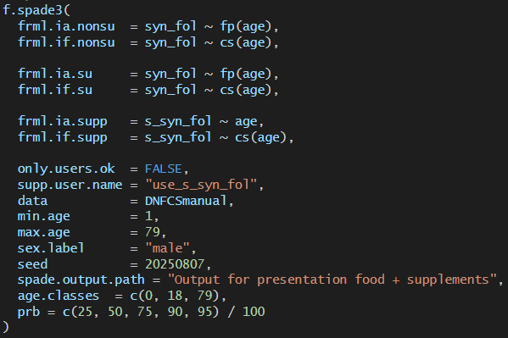
Bootstrap exercise 1
a) Rerun the model of synthetic folate for men – distinguishing youth and adults (see exercise 2 of food + supplements)
b) Construct the corresponding bootstrap call and run it. Start with n.boot = 3 to see if you don’t get any errors. If it runs fine, use n.boot = 10. Normally we recommend (at least) n.boot = 200, but we want to save some time. c) Find the mean (AM) total syn_fol habitual intake for both youth and adults. Also find the confidence intervals. Based on these results, do you think mean HI is significantly different between youth and adults?
d) Find the mean (AM) syn_fol habitual intake from foods only, separately for supplement-users and non-supplements users. Do this for both youth and adults separately. Also find the confidence intervals. Based on these results, do you expect the mean habitual food intake to be different between supplement-users and non-supplement users? Answer the question for youth and adults separately.

Slide 24
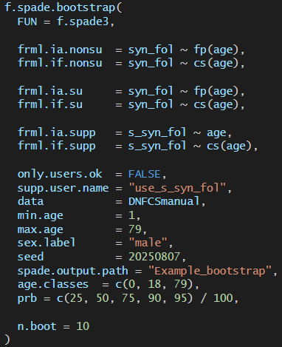
Solution 1b)
Original f.spade3 call:
Bootstrap call:

Slide 25
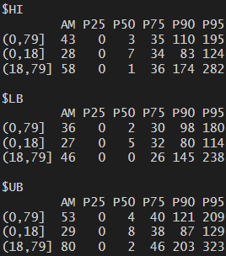
Solution c)
From the console aka logbook: (info can also be found in excel-file)
Total syn_fol intake
LB
UB
HI
youth:
28
LB
UB
27
29
HI
adults:
46
58
80
Seems to be a significant difference.

Slide 26
Solution d)
Info can be obtained from the excel-file (several tabs)
Syn_fol intake from food only
LB
UB
HI
Youth - suppl. users - non-suppl. users
9.3
10.3
12.9
Doesn’t seem like a significant difference.
LB
UB
HI
8.7
10.4
11.6
LB
UB
HI
8
Adults - suppl. users - non-suppl. users
LB
9.3
12.9
15.4
HI
UB
Seems like a significant difference.
5.6
7.6
9.2

